Slide 1
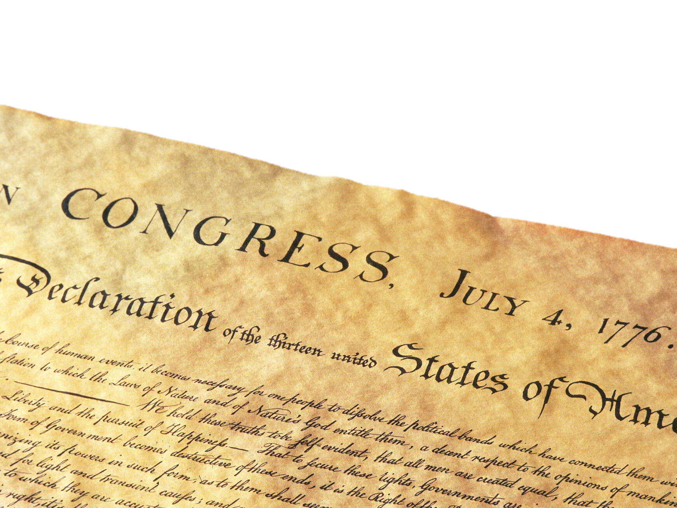
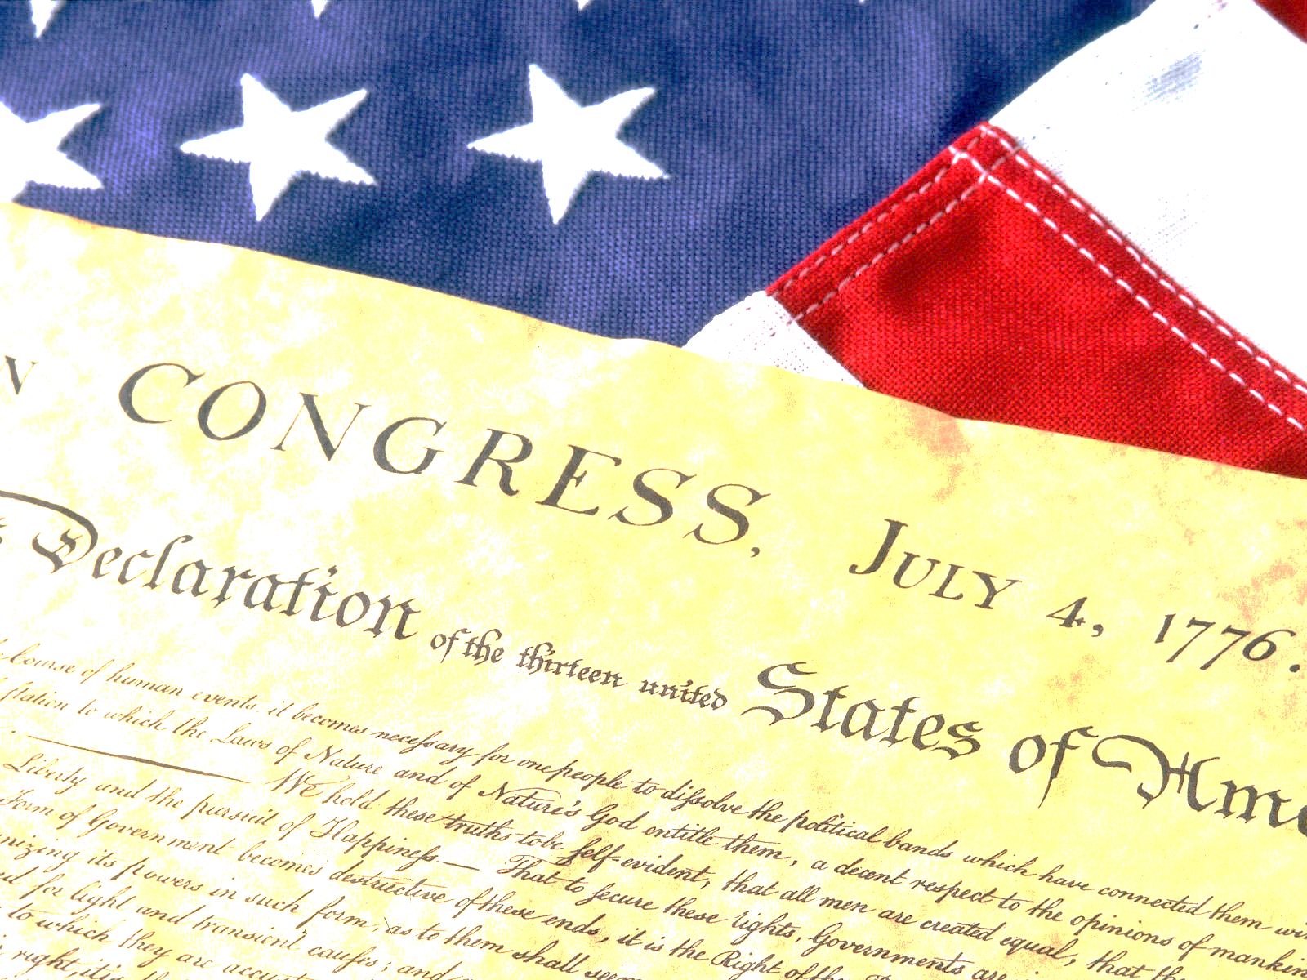
The Declaration of Independence

Slide 2
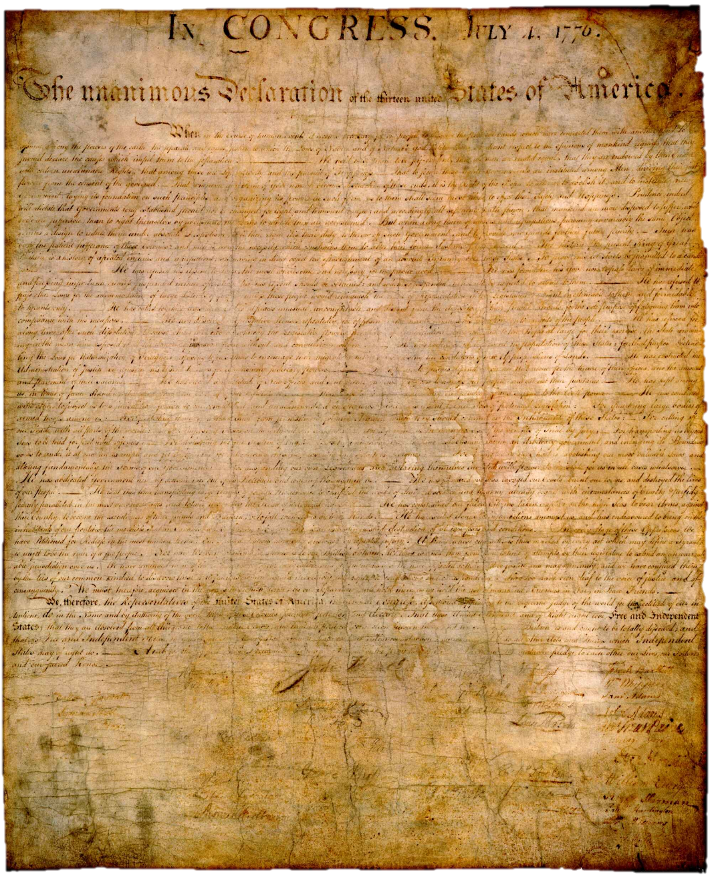
The Declaration of Independence
The unanimous Declaration of the thirteen united States of America.

Slide 3
The Declaration of Independence
When in the Course of human events it becomes necessary for one people to dissolve the political bands which have connected them with another…

Slide 4
The Declaration of Independence
and to assume among the powers of the earth, the separate and equal station to which the Laws of Nature and of Nature’s God entitle them,

Slide 5
The Declaration of Independence
a decent respect to the opinions of mankind requires that they should declare the causes which impel them to the separation.

Slide 6
The Declaration of Independence
We hold these truths to be self evident, that all men are created equal

Slide 7
The Declaration of Independence
that they are endowed by their Creator with certain unalienable Rights,

Slide 8
The Declaration of Independence
that among these are Life, Liberty and the pursuit of Happiness.

Slide 9
The Declaration of Independence
That to secure these rights, Governments are instituted among Men,

Slide 10
The Declaration of Independence
deriving their just powers from the consent of the governed.”

Slide 11
The Declaration of Independence
That whenever any Form of Government becomes destructive of these ends, it is the Right of the People to alter or abolish it, and to institute new Government laying its foundation on such principles and organizing its powers in such form, as to them shall seem most likely to effect their safety and happiness.

Slide 12
The Declaration of Independence
Prudence, indeed, will dictate that governments long established should not be changed for light and transient causes; and accordingly all experience hath shown that mankind are more disposed to suffer, while evils are sufferable, than to right themselves by abolishing the forms to which they are accustomed.

Slide 13
The Declaration of Independence
But when a long train of abuses and usurpations, pursuing invariably the same object evinces a design to reduce them under absolute despotism, it is their right, it is their duty, to throw off such government, and to provide new guards for their future security.

Slide 14
The Declaration of Independence
Such has been the patient sufferance of these colonies; and such is now the necessity which constrains them to alter their former systems of government.

Slide 15
The Declaration of Independence
The history of the present King of Great Britain is a history of repeated injuries and usurpations, all having in direct object the establishment of an absolute tyranny over these states. To prove this, let facts be submitted to a candid world.

